Slide 1

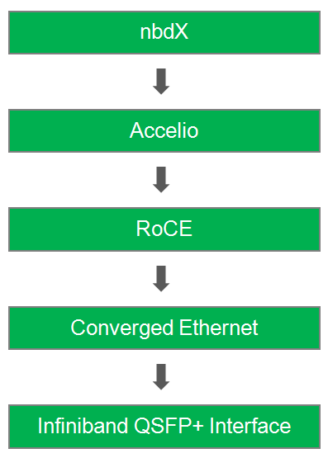
NVMe Over Fabrics
Kevin Cheng, John Gemignani, Coy Humphrey, Eric Litvinsky, Jayden Navarro, Alice Yu
Abstract
Results
Testing Methodology
Sponsored by Hewlett-Packard Enterprise, the objectives of this project are to assemble and benchmark a functional protocol stack to provide high throughput transfers with low CPU utilization that could be ported to HP Enterprise’s 3Par storage systems. To benchmark the servers, we created a custom test suite that determined read, write, buffer size, and seek performance.
[Work in progress]
[Insert graphs and pictures of results here]
Test suite:
FIO and the ib_send_* family of commands run by Python benchmarking framework
Data results were automatically parsed and outputted to CSV files, allowing for easy graph creation.
FIO was used to test nbdX and local ramdisk sequential and random read/write speeds, collected in the form of IOPS, bandwidth, and transfer latency.
A ramdisk was used on the server to emulate a fast storage device because we did not have access to a suitable NVMe SSD.
Data gathered:
Bandwidth/Latency of RoCE connection
Bandwidth/Latency/IOPS of nbdX device and local ramdisk
Functional Protocol Stack
Infiniband QSFP+ Interface
40gbit holy shit
Hardware support for RDMA I think!
Interconnect system for the I/O ports
Supports Ethernet, Fibre Channel, InfiniBand, and SONET/SDH standards
QSFP+ transceivers support Serial Attached SCSI, 40G Ethernet, 20G/40G Infiniband, and other standards.
Converged Ethernet
Lossless
Bridgey
Convergey
Flow controlly
RoCE v2 (RDMA over Converged Ethernet)
RDMA is Remote Direct Memory Access that is capable of allowing server to server data movement management without any CPU involvement
Accelio
Accelio is a library for high-performance asynchronous IO using RDMA
Zero-copy data delivery
Designed for multi-core CPUs and multi-threaded applications
nbdX
A network block device over Accelio framework that utilizes the RDMA protocol
Presented as a regular storage block device on the local system
Provides fast IO to remote devices through its use of accelio acceleration facilities and multi-queue implementation in the block layer
Technologies/ Methodologies Used
Software
Languages
C (I/O file creation program)
Python (Benchmarking framework)
CentOS 7.2
Accelio and nbdX
Hardware
HPE Proliant servers (x2)
HPE Infiniband FDR//Ethernet 2-Port Adapters (x2)
Conclusion
Through our benchmarking, we have found that the current nbdX technology was able to perform [well | poorly] compared to a local ramdisk in terms of IOPS, throughput, and latency. In terms of overall use, we found nbdX to suffer from many of the pitfalls that are commonly seen in emerging technologies, such as stability issues and a lack of edge case handling. A new driver is due to be released in the coming months by the NVMe over Fabrics Consortium, and is foreseen to replace the current nbdX software. The new driver is expected to improve the reliability of the technology. With increased stability with the new driver, Accelio supported networks should benefit from lower CPU utilization, faster data transfers, and lower latency compared to their non-RDMA equivalent infrastructures.
Acknowledgments
We would like to thank:
Samuel Fineberg, Distinguished Technologist, Hewlett Packard Enterprise
Linda Werner, Faculty Advisor, UCSC
Daniel Fava, Teaching Assistant, UCSC
HPE for the hardware and support provided

